Slide 1


Slide 2
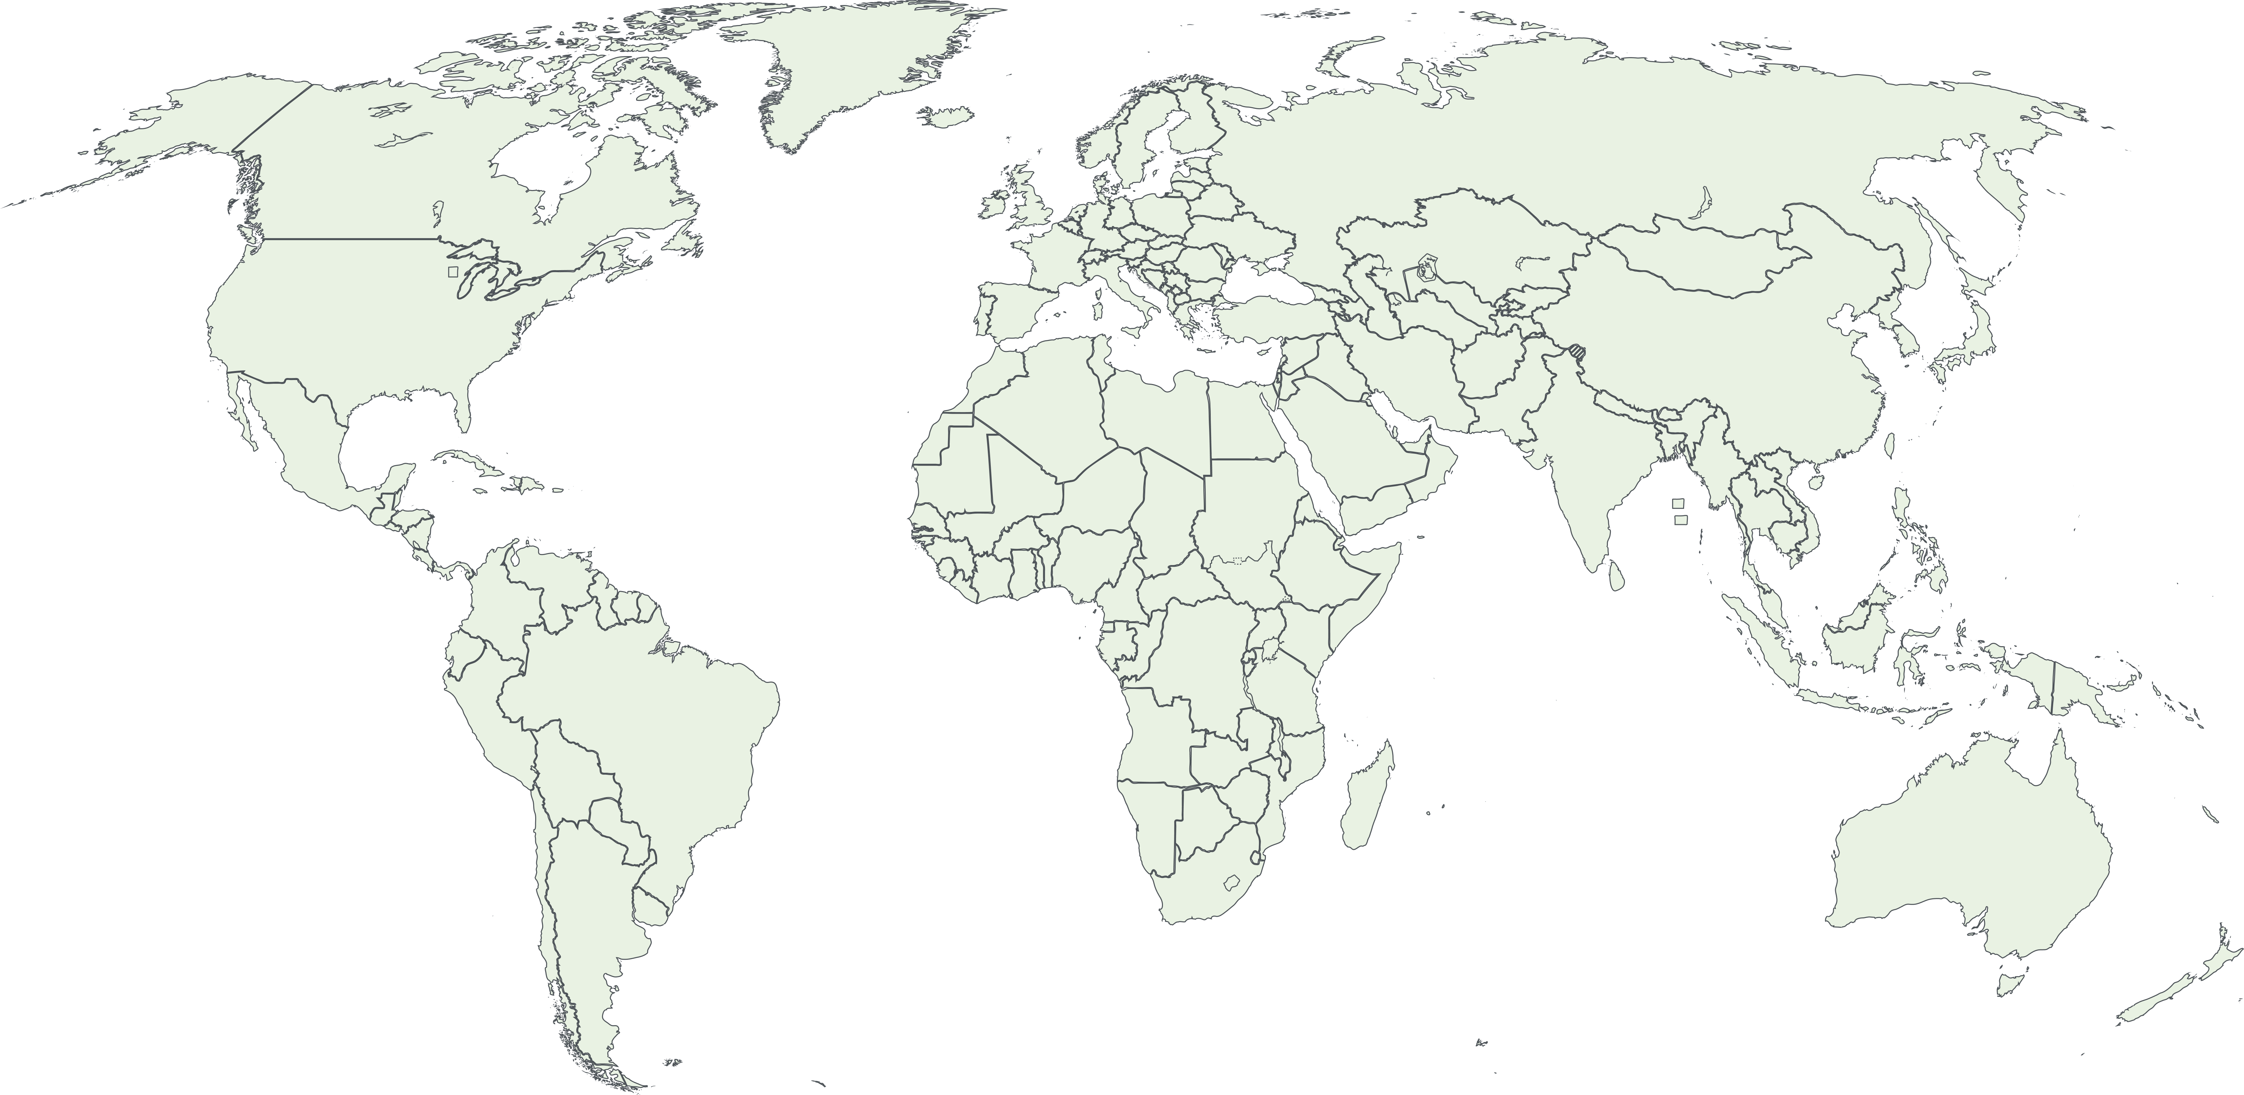


Physical officies
Cooperations
Notes:
We are 200 employees in Sweden but work internationally with staff or strategic partnerships in Brussels, Silicon Valley and Tel Aviv, among others.
In addition, we work with 11 prioritiezed countries, primarily based on the government's prioritized innovation partnerships, which means that we work closely with our sister authorities in those countries
Our instructions state that Vinnova’s task is to promote sustainable growth by financing needs-based research and development of effective innovation systems.
Our mission is to enable innovation that makes a difference.

Slide 3
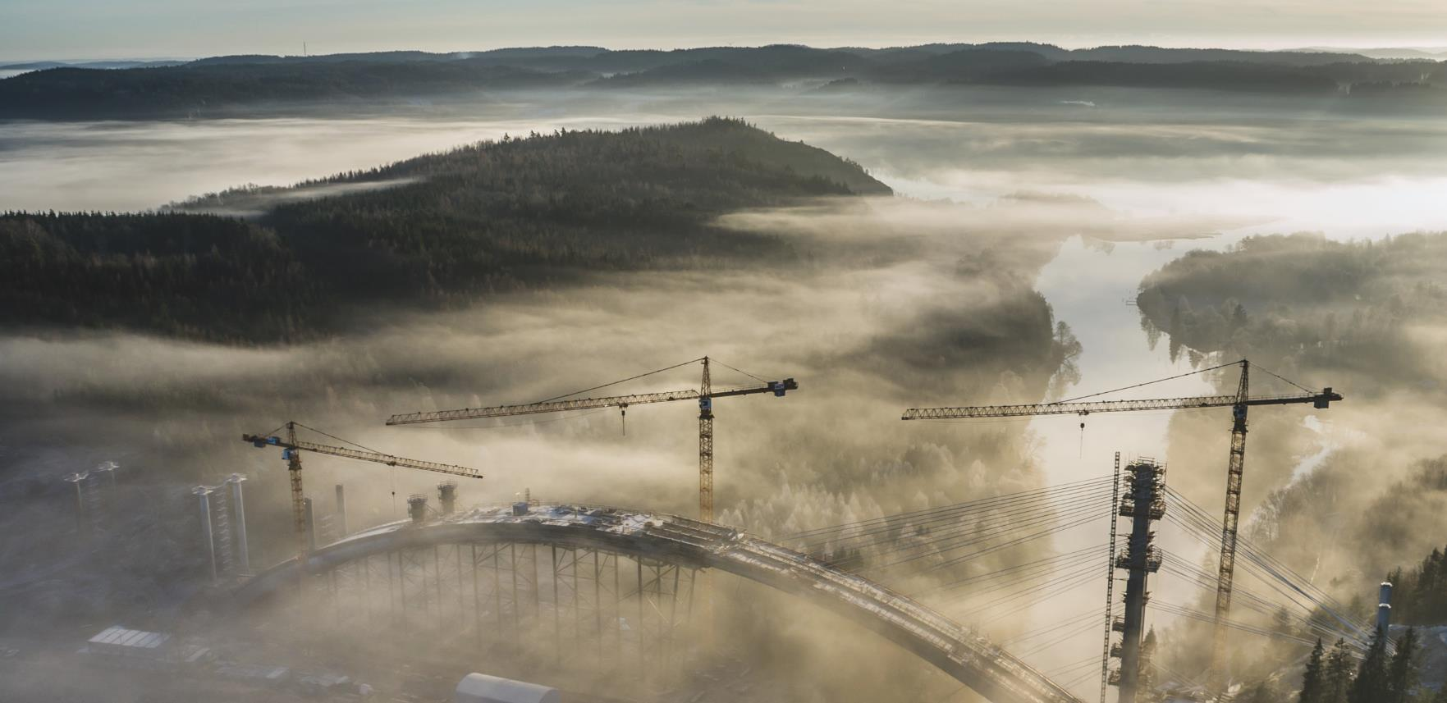
Global cooperation is crucial
For a sustainable future
Photo: Per Pixel Persson
Notes:
Innovation and global cooperation are a crucial for creating a sustainable future.
We have both innovation collaborations with a number of countries and are the liaison authority for the EU framework program for research and innovation.
In our role as funder, we work with Horisont Europa, the EU's framework program for research and innovation.
Innovation is increasingly taking place in international networks and our business community also operates most often in an international market.
Therefore, it is central to our entire activities have an international perspective on what we do.
We connect companies and organizations in Sweden with actors in other countries and promote international collaborations in research and innovation.
We work actively to make the international perspective a natural part of our entire activities.

Slide 4

Identify
Mobilise
Fund
Photo: Johnér bildbank
Notes:
What role does Vinnova play as an innovation agency?
A responsibility to reinforce Sweden’s innovative capacity.
Innovation is needed throughout our society to meet the challenges we face and to increase Sweden’s competitiveness.
We note that we need to take on a broader role, not only as a provider of funding but as an agent of change sharing our expertise.
This can be a matter of identifying, mobilising and funding projects to reinforce Sweden’s innovative capacity.
Identify:
Identify is about finding areas where we need to strengthen the ability to innovate (to, for example, achieve the Agenda 2030 goals or strengthen Sweden's competitiveness).
We work continuously to analyze research reports, gather actors on various issues and identify needs where efforts are required.
Identifying can also be about:
find areas within the innovation system that need to be strengthened, through, for example, an incubator development program.
find societal challenges where market actors do not do the work themselves but need help to stimulate change
Identify the need for a strong niche in Sweden to remain competitive - where initiatives and funding from Vinnova can act as a catalyst.
Mobilize:
Based on the needs and opportunities that we identify, develop and initiate appropriate efforts to mobilize and strengthen the ability to innovate.
It can be about opening up for - or sometimes even forcing - collaborations nationally and internationally to enable change at the system level.
Initiating collaboration between (new) actors within a system becomes increasingly important when no actor can solve the challenge himself.
We annually arrange a number of meetings and events that create conditions for mobilizing different actors.
Here we become the lubricant for the machinery to start spinning.
We also initiate calls in areas where we want to promote innovation.

Slide 5

SEK 3,7 billion
Our role as a funder is significant
Photo: Johner Bildbank
Notes:
Our role as a funder is significant.
2022 funded Vinnova almost 4000 projects for a total amount of 3,7 billion.
As innovation is needed throughout society, the projects we fund span many areas of society and sectors, both in privately and publicly funded activities.
It can be anything from project to promote social and norm-critical innovation to innovation in the mine with 5G technology.
Our funding reaches many. Companies, universities, institutes, non-profit organizations and the public sector.

Slide 6
Innovative capabilities and societal challenges
SOCIETAL CHALLENGES
Sustainable industry
Sustainable built environ-ments
Sustainable precision health
Sustainable mobility
Sustainable
food systems
Digital transformation
INNOVATIVE
CAPABILITIES
Ecosystems for innovative companies
Future areas of innovation
Notes:
We’re focusing on 8 areas, where we take a unified approach to stimulate innovation in a broad sense: five societal challenges and three innovation capabilities.
Common to the areas is that:
We mobilize actors from different parts of society towards common objective
We identify important needs
We fund research and innovation that promotes development
In the work, we involve different actors and a wide range of competencies. Sustainability, gender equality and international competitiveness are priority perspectives in all areas.

Slide 7

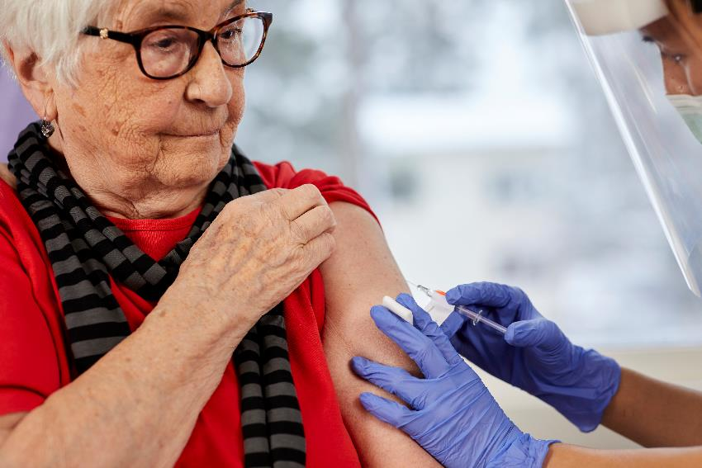
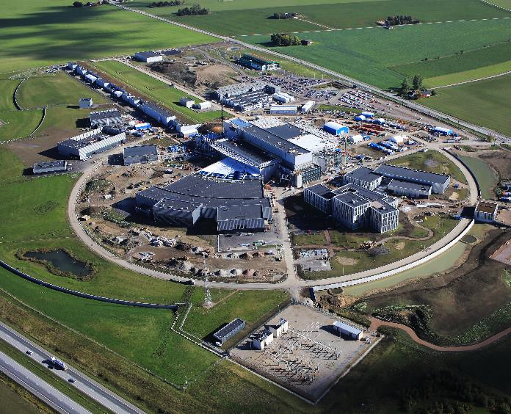
Horizon Europe
We’re the link to
EU funding
Notes:
We are the Swedish link to EU funding
In our role as funders, we also work with Horisont Europe, the EU's framework program for research and innovation.
The program is the world's largest effort on research and innovation and has a total budget of around 95 billion euros.
Horisont Europe means significant funding opportunities for Swedish research and innovation actors as well as opportunities to participate in European collaborative projects for technology development and solutions to societal challenges.
Vinnova has the role to disseminate Horisont Europe in Sweden and helps organizations to seek EU funding for their project.
Swedish organizations were granted more than EUR 2 billion under 2014-2020, corresponding to 3.4 per cent of allocated funds, which makes Sweden one of the ten most successful countries in the framework program.

Slide 8

Opportunities from Vinnova
Staff exchange for applied AI, automation and data sharing 2023 | Vinnova
Fellowship at Vinnova's office in Silicon Valley
Convergence Accelerator
IndTech, Future mobility, Future precision health, Green transition initiative
Notes:
In this call, Swedish actors can apply for a grant for staff exchange between Sweden and USA, in order to increase the organization´s AI competence and initiate long-term cooperation.
You can apply for up to 500 000 SEK and you need to co-finance with the same amount of money.
The scholarships are aimed at people with a good understanding of startups and who wish to develop their network and their competence. The scholarships offer the opportunity to spend 10 months at Nordic Innovation House and actively contribute to the business there.
Indtech: focus on strategic partnerships with industry and academia in digitalization within industrial technology
Future mobility: Connection to the ecosystems that in the US for each plattform
Future precision health:
Green transition initiative:

Slide 9
Sweden Innovation Days
21-23 March 2023
www.swedeninnovationdays.se
Notes:
This digital event (free of charge) will focus on how to enable innovation that has a real impact on our society, environment and economy. Despite Sweden being a climate front runner, we still have a responsibility to contribute to the Global Goals.
During the conference we will present how Swedish agencies and industry are paving the way for the Swedish innovation ecosystem to experiment and grow. Discover some great real life examples of how actors are successfully innovating and finally learn about the impact these innovations have had on our society.
The event is dedicated to fostering international collaboration, so whether you are a startup, intermediary or corporate, working in the public sector, civil society, academia or a government agency, there will be something for everyone. We all need to be part of the innovation journey!

