Slide 1
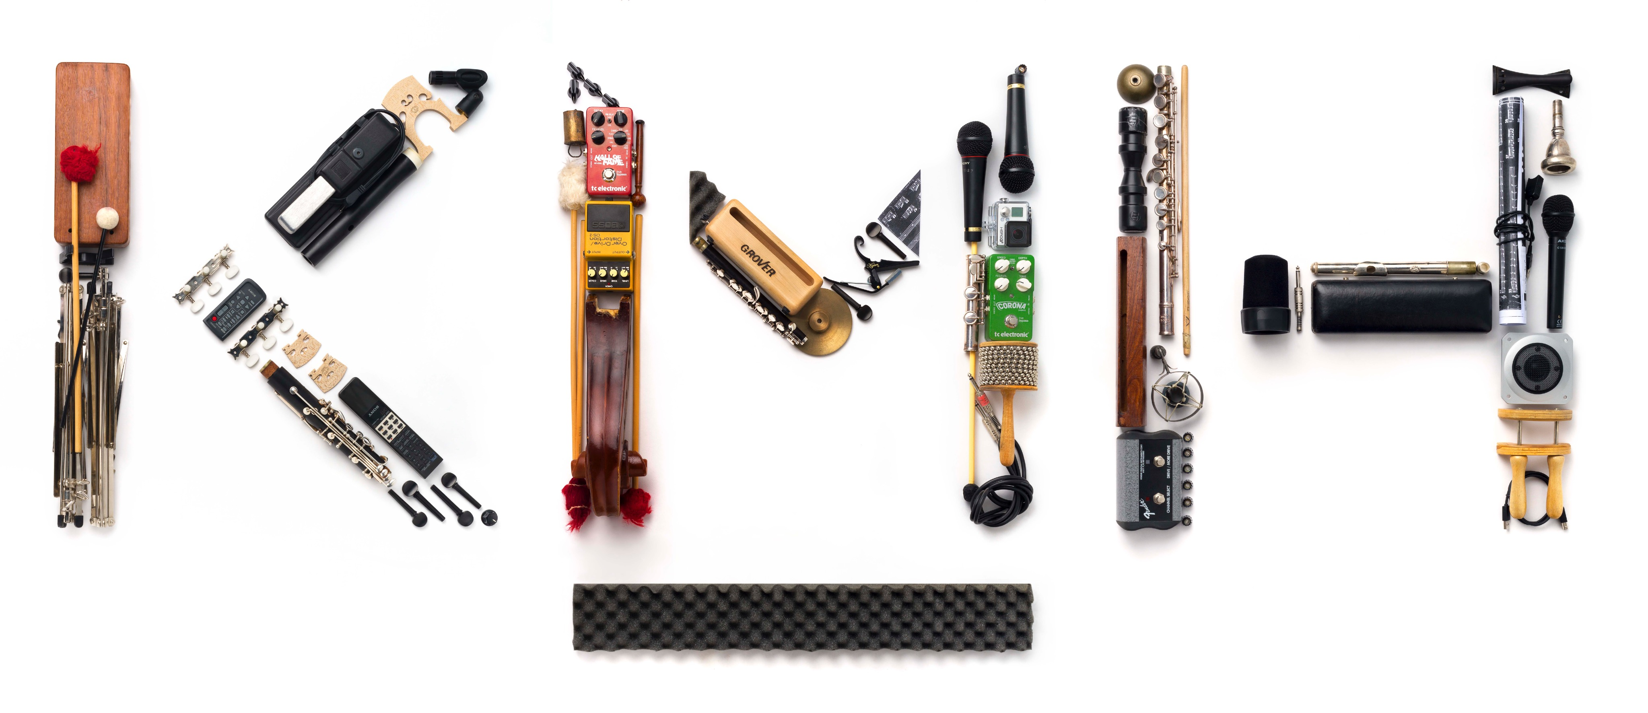
Enriching Learning Environments via Music and the Arts SIREUS CHANCELLORS FORUM 2023 FEBRUARY 21-22 2023 WASHINGTON DC
Eva Bojner Horwitz, Professor, Dr.
Dept. of Clinical Neuroscience, Center for Social Sustainability CSS, Karolinska Institutet & Royal College of Music, Stockholm, Sweden
Julia Langley, MA, MBA, Faculty Director, Georgetown Lombardi Arts and Humanities Program, Georgetown University
Anthony Hyatt, Medical Musician & Teaching Artist

Slide 2
The Emotional Brain ”Sneaking through the backdoor into the brain”
Le Doux´s (1993) surprise effect:
Some responses go on a fast track
directly from thalamus down to the
amygdala nuclei without passing
through parts of the brain
associated with rational thoughts.
We become affected without
understanding why.
Notes:
How does this work?
Snsory cerebral cortex

Slide 3
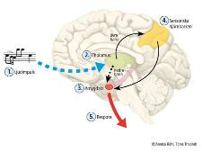
What music does is involved in creation of social sustainability:
Empathy, emotions & memories
Movements and motor planning
Sound impressions
Executive functions
Language learning & reading
Higher order thinking
Visiospatiality
Notes:
Social sustainability occurs when the formal and informal processes; systems; structures; and relationships actively support the capacity of current and future generations to create healthy and livable communities.

Slide 4
Multi-, Inter- and Transdisciplinary work
Multi-
Inter-
Trans--
Notes:
The apparent simplicity of this approach is deceptive, with a recent article on this topic concluding that
‘despite the rhetoric and apparent enthusiasm for crossing disciplines [it] remains relatively difficult
to initiate, fund, publish and sustain’ (Larson, Landers, & Begg, 2011, p. 41).

Slide 5
Bridge knowledge & pedagogies from different disciplines with STEMM
Integrate learning experiences from the Humanities and Arts with:
Science,
Technology,
Engineering,
Mathematics and
Medicine -→ STEMM

Slide 6
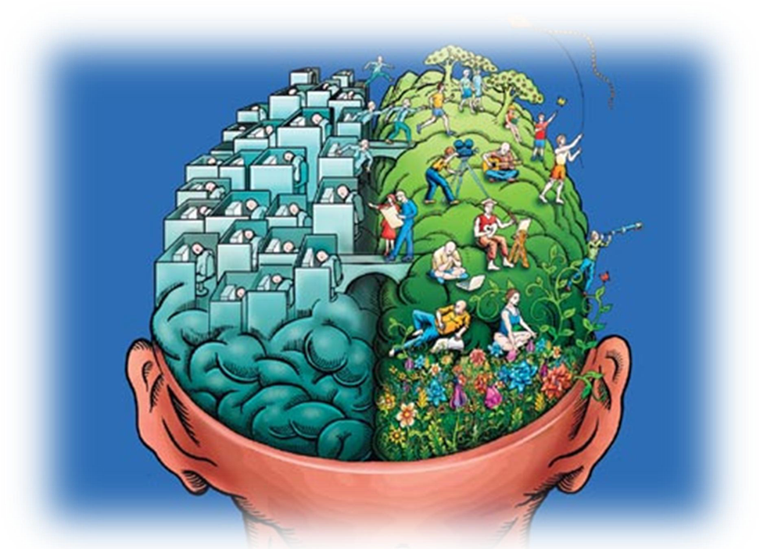
Integrating Arts & Humanities in STEMM -> Positive Learning Outcomes:
Increased critical thinking abilities
Higher order thinking
Content mastery
Problem solving
Team work and communication skills
Improved visiospatial reasoning and
General engagement and enjoyment of learning

Slide 7
”All religions, arts, and sciences are branches from the same tree” Albert Einstein
”Faculties who are concerned that an education focused on a single discipline will not best prepare graduates for the challenges and oppurtunities presented by work, life and citizenship in the 21st century”
Our students today will look forward not only to several jobs but also several careers..
Ref: The National Academy of Sciences, Engineering & Medicine – A Consensus Study Report
Notes:
Positive learning outcomes such as:
Increased critical thinking abilities
Higher order thinking
Content mastery
Problem solving
Team work and communication skills
Improved visuospatial reasoning and
General engagement and enjoyment of learning

Slide 8
Painting observation in STEMM

Slide 10
The Art of Observation
1. Observe the BIG picture
2. Notice the small details
3. Evaluate
4. Interpret
5. Communicate

Slide 11
Separation of observation & interpretation enhances communication -> skills that can be trained !!
Notes:
80%

Slide 12
Visual Art to Transform Learning Skills Why do we need Arts & Music Integration in Education?
Creative Problem Solving & Embodied Learning
Critical & Ethical Thinking and Reflection
Systems Thinking & Analyses
Collaboration and Partnership
Empowerment of new & different ideas
Notes:
Positive learning outcomes such as:
Increased critical thinking abilities
Higher order thinking
Content mastery
Problem solving
Team work and communication skills
Improved visuospatial reasoning and
General engagement and enjoyment of learning
the ability to
understand and associate synergies in different
aspects of a social system
Partnership through Dialogue and
negotiation

Slide 13
Transformative learning is a prerequisite
to be able to implement change
In order for society to develop in a more sustainable direction
in addition to learning about what is unsustainable that needs to change - we should also learn how we create this change.
Notes:
Bank of England: “ största transformation sedan industr. revol.
Tydlighet gällande samverkan mellan myndigheter
Bottom up

Slide 14
Complex identification
It is the ability to identify and reason in complex questions that needs to be practiced
Aesthetics, art and music activities develop transformative learning processes!
Notes:
INGJUTA HOPP OCH MOD I NÄSTA GENERATIONS MUSIKER

Slide 15
”The evidence behind the assertion that educational programs that mutually integrate learning experiences in the humanities and arts with STEMM lead to improved educational and career outcomes for undergratuate and graduate students”

Slide 16
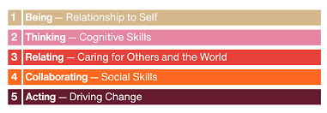
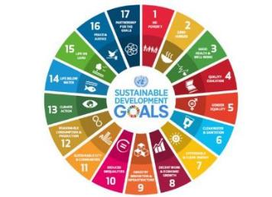
Arts and Music are drivers for social sustainabilty. -> Sustainable and Healthy Working Life Inner Developmental Goals - IDG
An Agenda for Research on the Sustainability of Public Health Programs Scheirer and Dearing, Review 2013
Notes:
Center for social sustainability
An Agenda for Research on the Sustainability of Public Health Programs
Scheirer and Dearing, Review 2013

Slide 17
Thanks!
eva.bojner.horwitz@ki.se
julia.langley@georgetown.edu

