Slide 1
Mapping of exchange programs with
American universities
WG2

Slide 2
Table of Content
Background
Categories and definitions
Distribution of "Exchange type" and "Agreement level"
Geographic distribution
"Financing" and "Balance in exchange"
"Surrounding offers", "Marketing strategy" and "Ambassadors"
Conclusions

Slide 3
Background
SIREUS' second goal aims to strengthen the relationship between Swedish and American universities.
In alignment with SIREUS second goal, the Swedish university members were asked to map their exchange program agreements they have with American universities.
An excel sheet was distributed and filled out by the Swedish Universities.

Slide 4
Categories and definitions

Slide 5
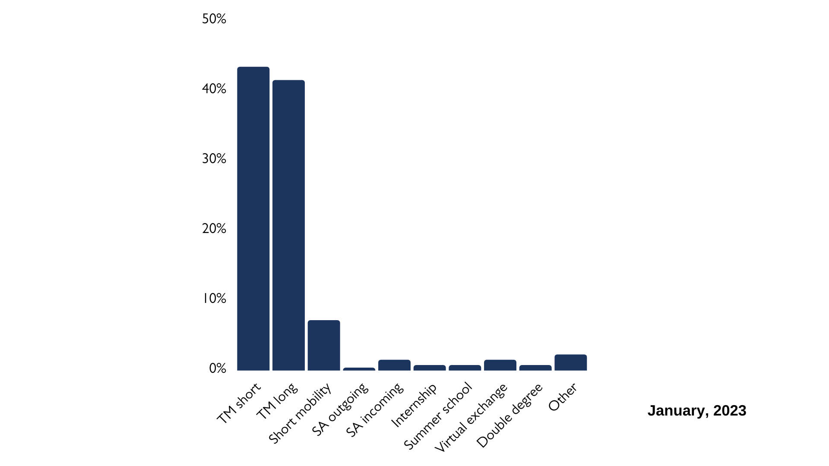
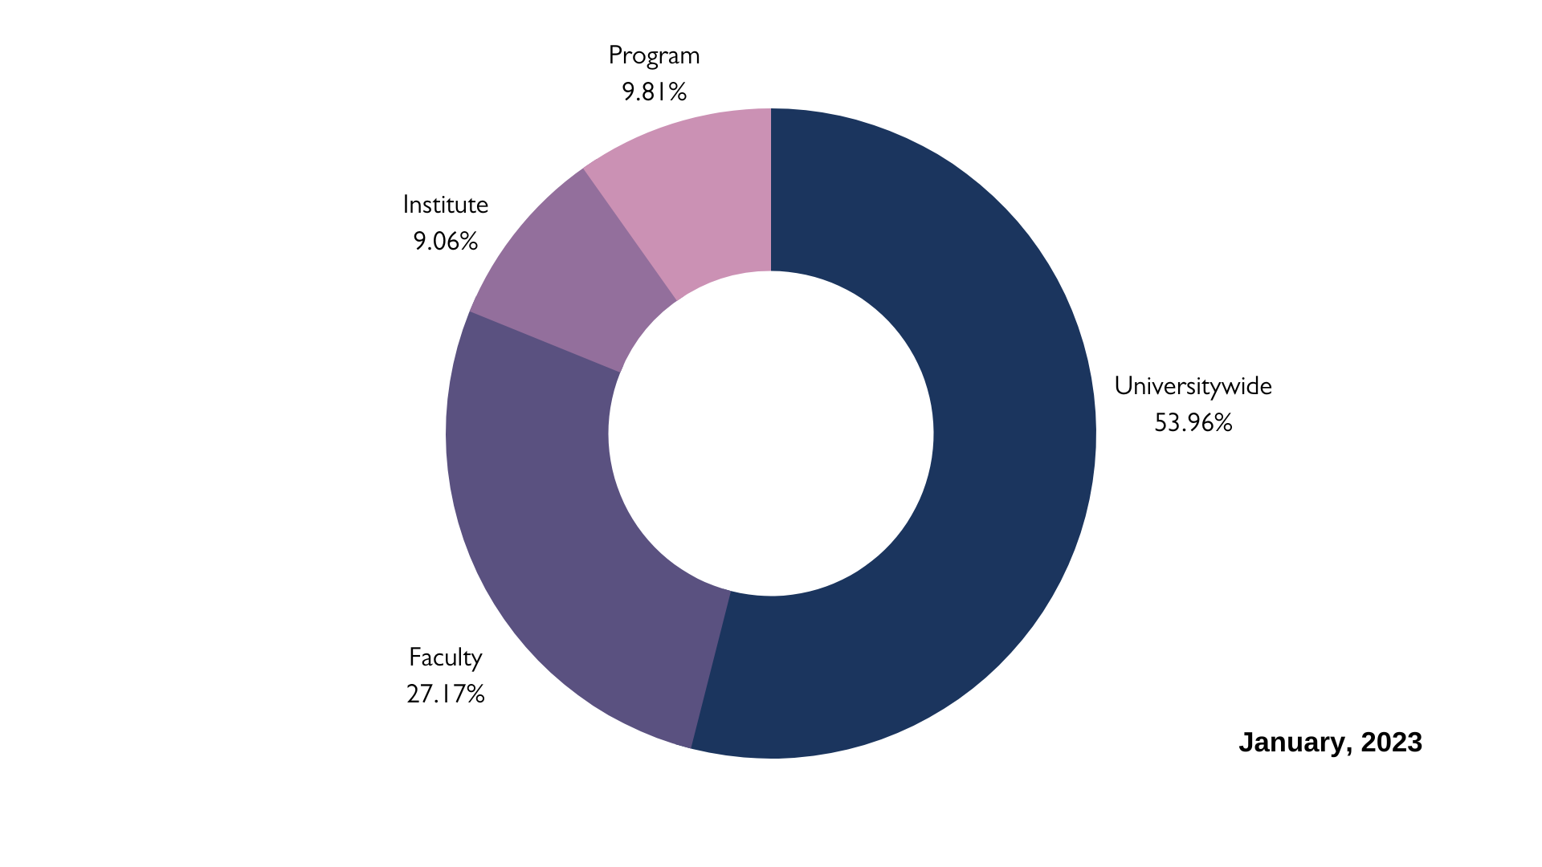
"Exchange type" and "Agreement level"
265 different agreements spread out across 46 states
Clusters: California, Illinois, Massachusetts, Minnesota, Maryland, and New York

Slide 6
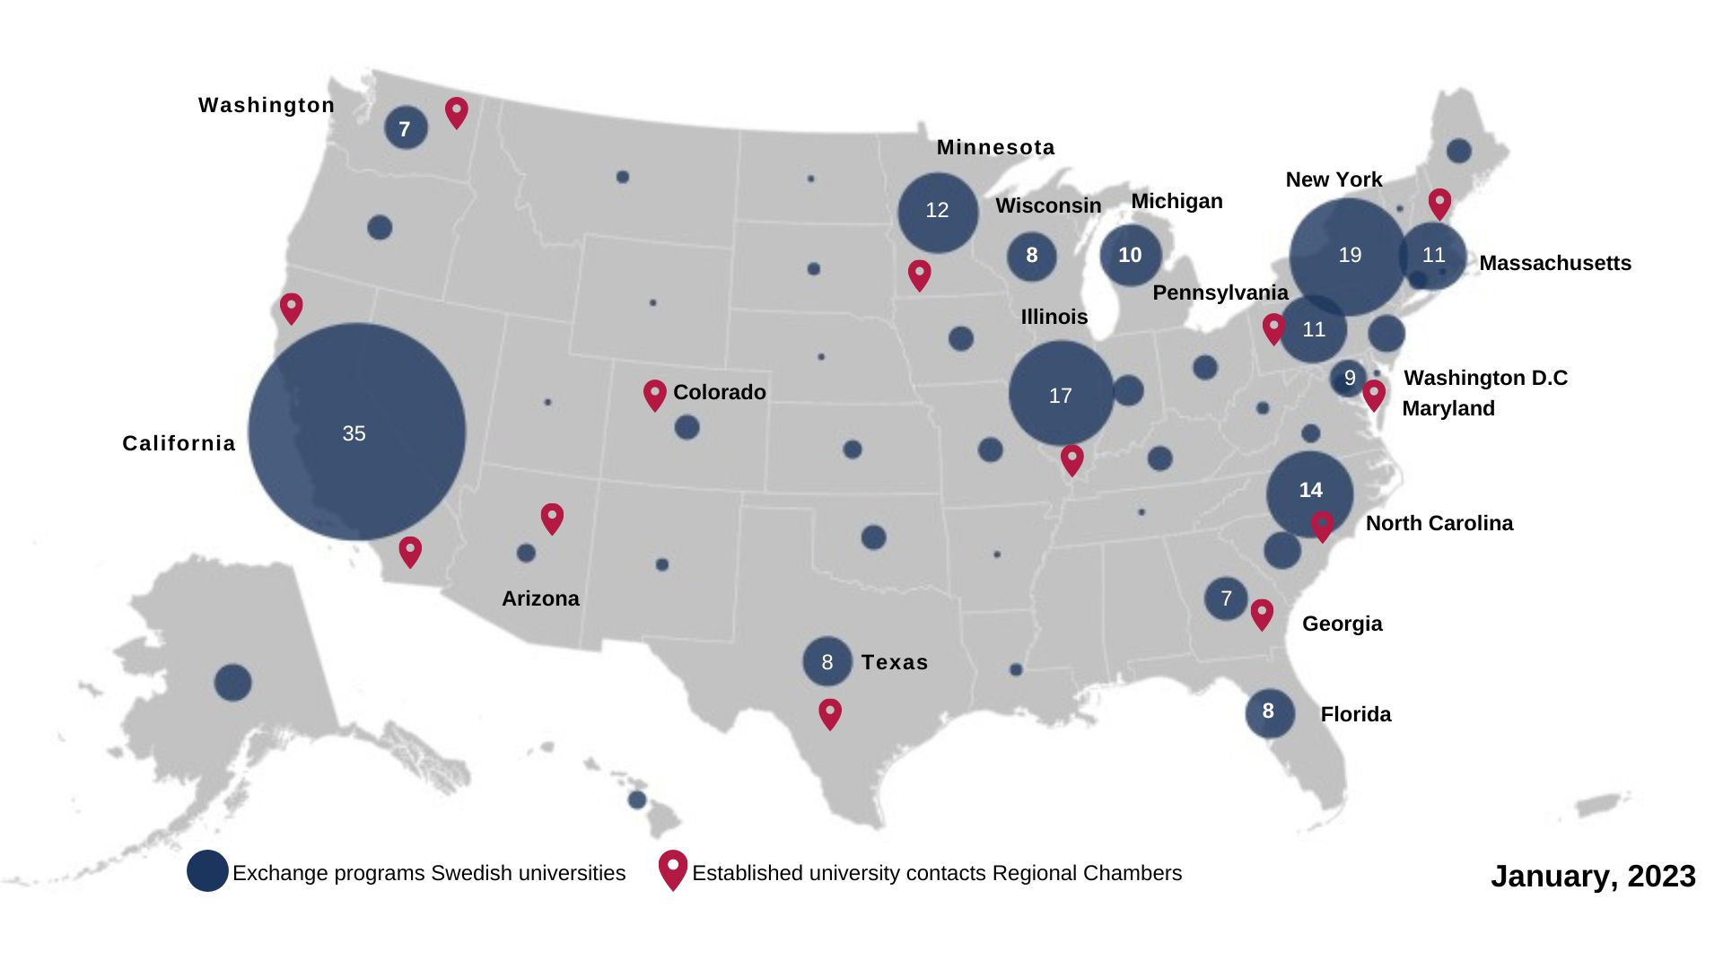

Slide 7
"Financing" and "Balance in exchange"
Mainly 1-1 exchange with no extra costs
Mandatory student fee and insurance fee was highlighted as extra costs on few occasions
Is it the requirement of balance or the actual balance that is of interest?
Two types of answers has been identified: "Balance/Imbalance" and "Requirement/No requirement"
There are also agreements with requirement of balance but with freedom to send more students
Makes it difficult to know how many agreements that has actual or requirement of balance
Do the universities that stated "requirement of balance" have actual balance?
Do the universities that stated "actual balance" have a balance requirement?

Slide 8
"Surrounding offers", "Marketing Strategy" and "Ambassadors"
"Surrounding offers"
Accommodation guarantee, possibility to apply for scholarship/waiver and collaboration with companies was brought up by three universities. However, over representation of "no specific offer"
"Marketing strategy"
Great variety; digital, informational meetings, faculty visits, student fairs at partner universities
In which direction is the marketing aimed at? Towards Sweden or USA?
"Ambassadors"
Specific group of ambassadors for exchange programs, ambassadors from specific institutes or designated individual

Slide 9
Conclusions
Small variations within each university while larger variations was identified between universities
This was visible in "exchange type", "ambassadors", "marketing strategy"
How does one know what works best?
It varied how each agreement was initiated. For specific details, see the excel sheet
One university commented that this mapping only covers bilateral agreements
Is it necessary to map networks or other "multilateral" agreements?
Where and on what do the universities want to put more effort?

