Slide 1
SACC-USA
SACC-USA

Slide 2
USA & SWEDEN
USA
SWEDEN
328 million
10 million
$21.428 trillion (2019)
Per capita: $62,794
$528.929 billion (2019)
Per capita: $54,608
The United States is a recognized leader in research and development (R&D), and registers more international patents than any other country
Sweden is recognized by a number of international indexes as one of the most innovative countries in the world
Notes:
The United States offers the largest consumer market on earth with a GDP of $20 trillion and 325 million people. Household spending is the highest in the world, accounting for nearly a third of global household consumption. At the same time, free trade agreements with 20 other countries provide enhanced access to hundreds of millions of additional consumers – and the United States continues to work with companies to increase opportunities for U.S. exporters.
The United States is a recognized leader in research and development (R&D), and registers more international patents than any other country. Today’s innovators are safeguarded by a robust intellectual property protection framework, while the innovators of tomorrow are nurtured at leading universities and incubators across the nation. Companies of all sizes help make innovation in the United States a global enterprise, benefiting from – and contributing to – a flourishing ecosystem for invention and inspiration.
Sweden is one of the most innovative countries in the world. A number of international indexes (such as Global Innovation Index, Global Creativity Index and Innovation Capacity Index) measure the ability of countries to foster innovation, and Sweden is usually found at the top. Sweden also has the third most registered number of patents per capita in the world.
Nearly four per cent of Sweden’s GDP goes towards research and development – one of the highest rates in the world. It is part of Sweden’s successful effort to be one of the world’s most innovative and research-intensive nations.
Sweden invests heavily in research, encourages independent thinking and is open to new influences. Other factors that contribute to this innovative spirit include schools that encourage creativity, and a society steeped in strong beliefs in cooperation, equality and diversity.
Sweden’s strong innovative culture is made possible due to factors such as economic stability, security, freedom of expression, tolerance and transparency. The inventors of dynamite (Alfred Nobel!), the pacemaker and ball bearings set the stage for contemporary inventors. An innovative spirit is a part of the Swedish sense of self.
Many old Swedish brands have managed to reinvent themselves and stay in tune with modern developments and technological progress. Sweden, with its excellence in sustainability and egalitarian methods, is also able to provide a bounty of solutions to an ever-increasing urgency to fight poverty, provide clean water and stop environmental destruction on a global scale.

Slide 3
USA & SWEDEN
Sweden recognized the United States in 1783 by signing a treaty negotiated by Benjamin Franklin. Diplomatic relations were established in 1818 and have remained unbroken since that time
The United States is Sweden’s largest trading partner outside Europe and the third largest export market for Swedish companies
Economic interactions with Swedish businesses and industry create more than 360,000 jobs in the United States
When you take subcontractors, infrastructure, and related services into account, the total reaches nearly one million jobs
Sweden and the United States share a focus on innovation as a driving force for economic growth and job creation
After Silicon Valley, Stockholm has the second largest number of billion-dollar startups per capita in the world
Approximately 25 percent of Swedish companies’ global revenue comes from the United States
Sweden is one of the largest investors per capita in the United States

Slide 4
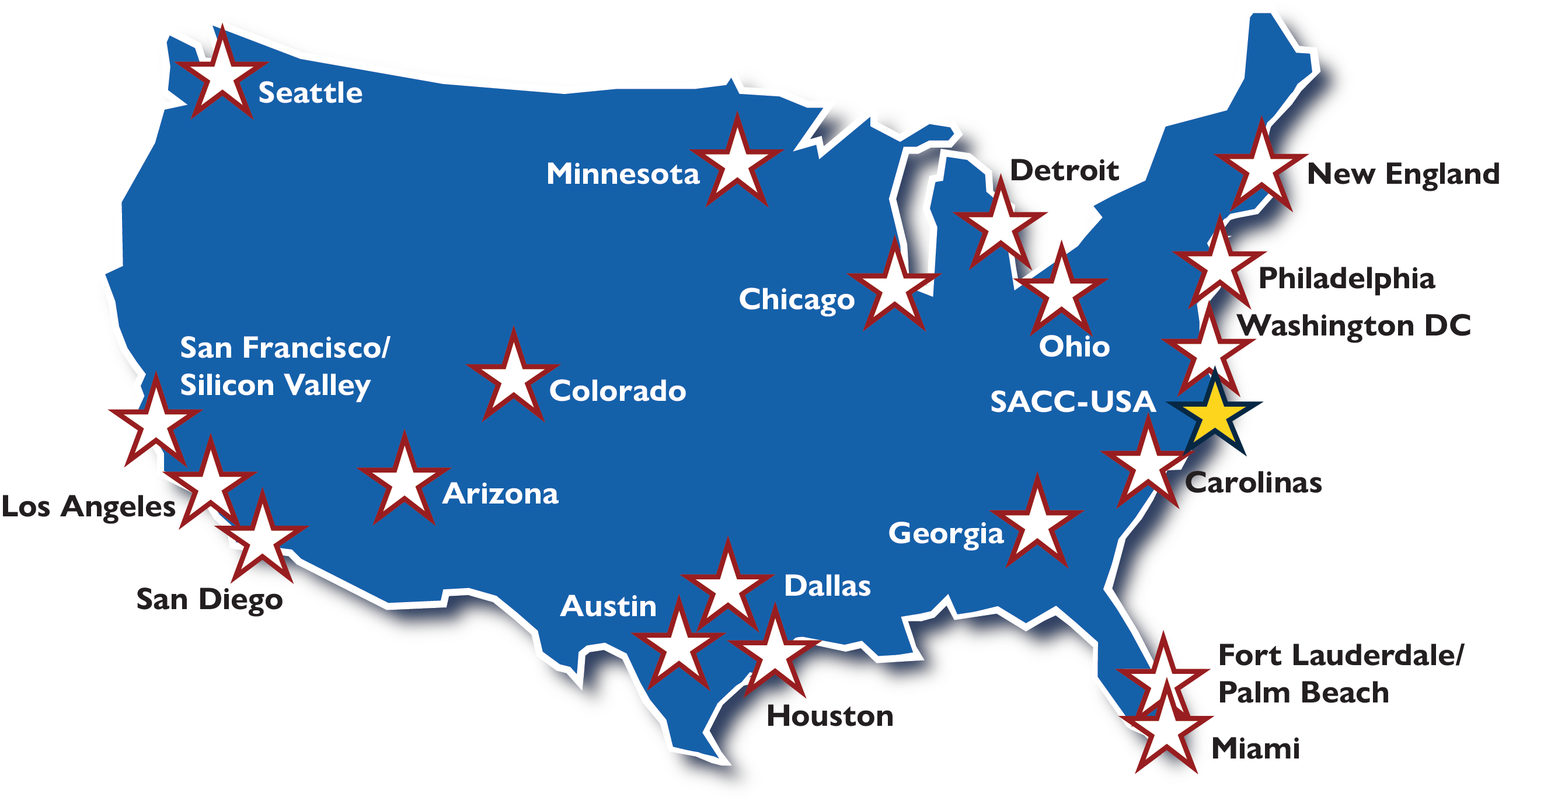
SACC-USA
ABOUT SACC
SACC-USA is a key player in the development of trade relations and investment opportunities between Sweden and the United States
As the second largest European Chamber of Commerce in the United States, we are here to help your company find the right contacts to enter, access and expand on the U.S. market
Our members enjoy the benefits of being part of a greater Swedish-American business community, getting business referrals from from valuable SACC connections, as well as access to our regional, national, and international network
Notes:
A membership in SACC-USA brings many advantages. In addition to tangible ones such as assistance with visitation programs and contacts at the local level as well as employee knowledge exchange, there are many intangible benefits associated with being part of a network that promotes Swedish-American trade relations and showcases Sweden as a technologically advanced country that values innovation and sustainability.

Slide 5
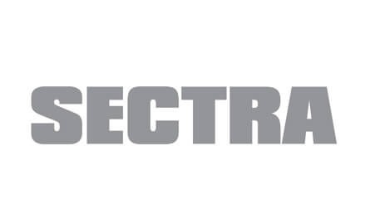
SACC MEMBERS
A SELECTION OF BUSINESS & CORPORATE MEMBERS IN THE SACC NETWORK
Notes:
Our valuable network consists of members in Sweden and the U.S.; it is an exciting mix of entrepreneurs and businesspeople, venture capitalists, economic developers, political leaders, individual members, universities, start-ups, and world leading corporate and business members.

Slide 6
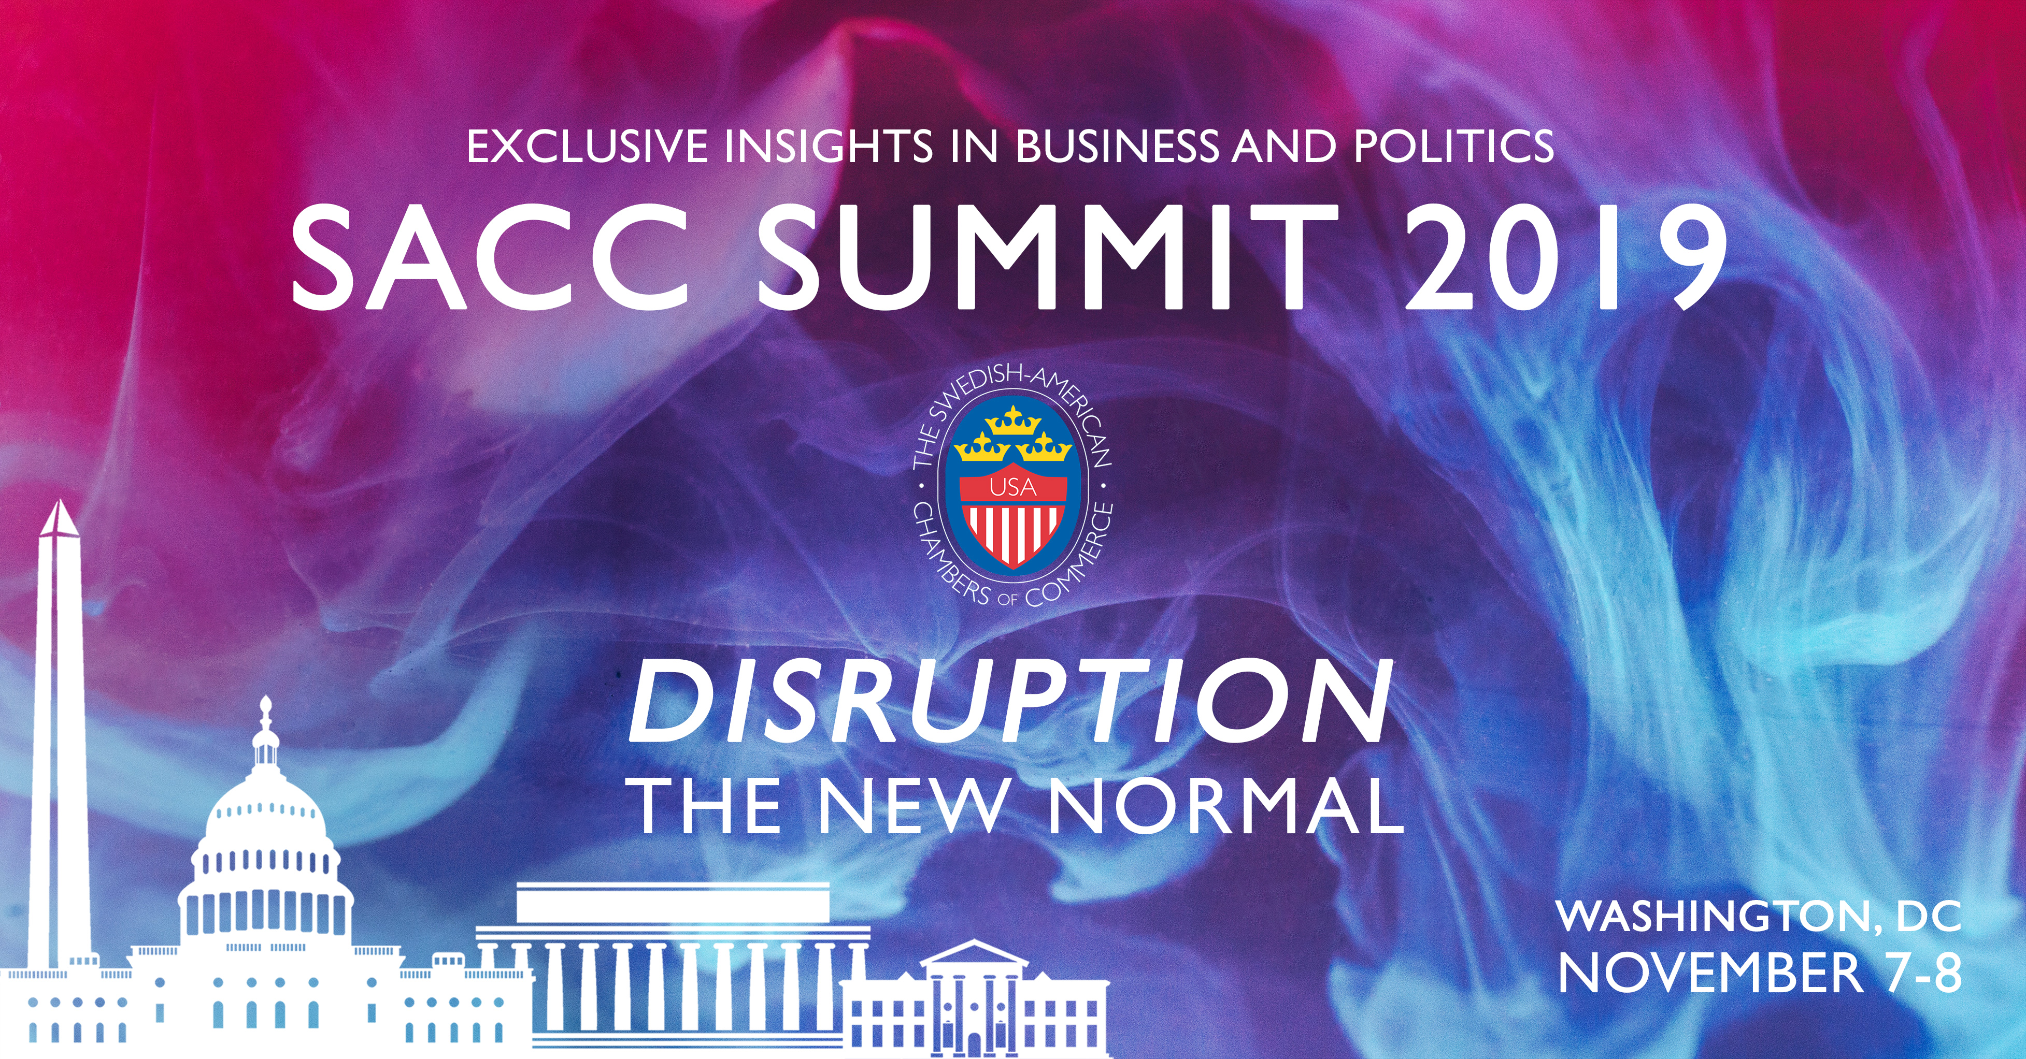
EVENTS
300 EVENTS ACROSS THE UNITED STATES ANNUALLY
We invite corporate members to speak at our events. Speaking engagements are another form of content marketing. Whether you are on a panel or giving a solo keynote, speaking at our events is a great way to get more exposure and more business on a regional, national, and international level
Our events calendar, including over 300 events annually, provides networking and professional development opportunities, including seminars, conferences, luncheons, and dinners where you have the chance to meet top executives, experts and pundits in our considerable network
Corporate members of SACC-USA are invited to attend our annual meeting via tele-conference and have a vote for the election of our board of directors. This is a very concrete way for our members to influence Swedish-American business relations
Notes:
Speaking engagements are another form of content marketing. Share how your company have influenced the US with Swedish values
Attending any of our 300 events across the country is an easy way to meet the top executives, experts, and pundits in our network. Let us know beforehand who you are particularly interested in meeting with and we will make initial introduction and assist with necessary follow ups after the event

Slide 7
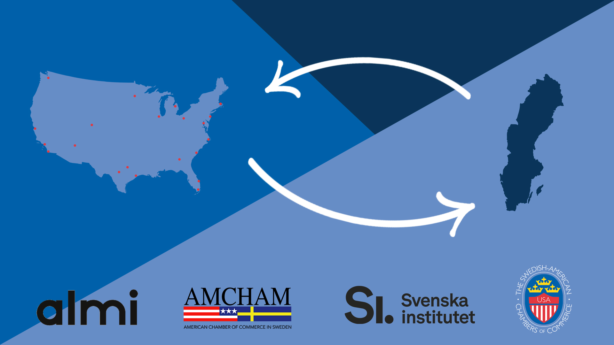
TALENT MOBILITY
The ability to attract foreign investment, talent, and visitors is one out of five strategic goals in Sweden’s export and investment strategy
SACC-USA’s bilateral talent mobility program provides concrete tools for implementing talent mobility between Sweden and the United States:
J-1 visa service for Swedes going to the United States for practical training in member companies
U.S. Talent to Sweden for Americans going to Sweden, facilitating the Swedish work permit for training
Having young people engaged in practical training, studies, and knowledge exchange in both directions between our two countries raises Sweden’s image as a destination for study, research, and work. With a membership in SACC-USA, you contribute to SACC-USA’s ability to promote Swedish higher education in the United States
Notes:
Sweden’s new export and investment strategy focuses on five strategic goals. The ability to attract foreign investment, talent and visitors is one of those goals. SACC-USA’s bilateral talent mobility program provides concrete tools for implementing talent mobility between Sweden and the U.S. by offering J-1 visa service for Swedes going to the U.S. for practical training and facilitating the Swedish work permit for training through our new program U.S. Talent to Sweden. Having young people engaged in studies and knowledge exchange in both directions between our two countries raises Sweden’s image as a destination for study, research and work. With a membership in SACC-USA, you contribute to SACC-USA’s ability to promote Swedish higher education in the U.S.
Ny bild med SACC AMCHAM och SI
An excellent resource to attract talent to your companie

Slide 8
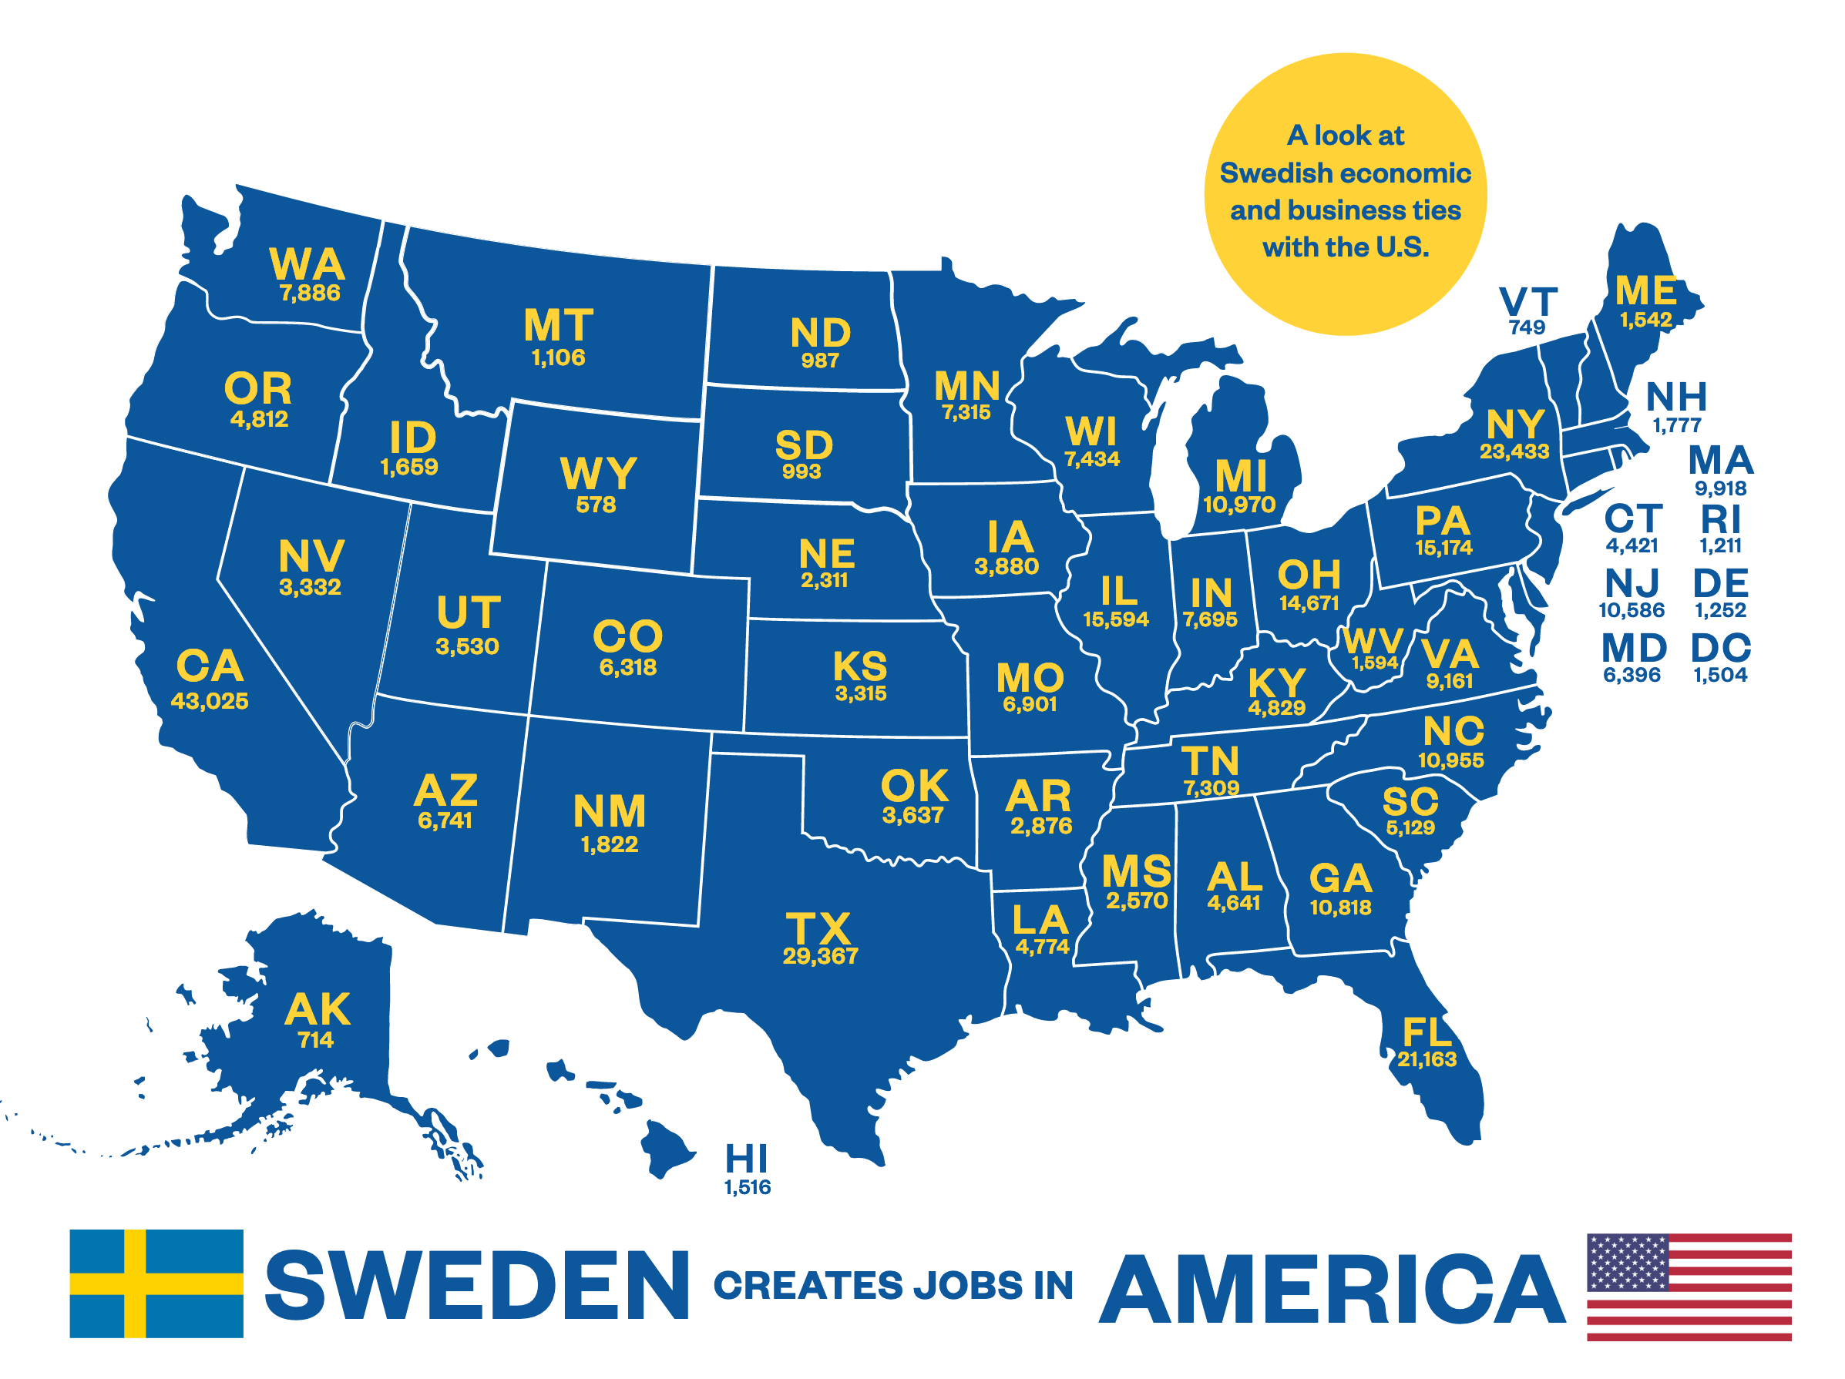
BUSINESS INTELLIGENCE
Stakeholder mapping
Market research
Reports
Sweden Creates Jobs in the U.S.
Business Climate Survey

Slide 9
TRADE DELEGATIONS
EXPLORE THE US MARKET, GAIN VALUABLE KNOWLEDGE AND BUSINESS CONNECTIONS
Thanks to our extensive regional chamber network, we can leverage our strong local knowledge and networks to tailor trade and business delegations and visiting programs to target your company’s needs and objectives, making the most of your trip to the United States
We can introduce you to top-level executives at U.S. headquarters. Meet with industry experts and learn from those who are already established to accelerate your potential on the US market
We are well-equipped to match you with the right investors and get you in contact with the accelerators and incubators best suited for your objectives
Some of the world’s best universities, think tanks, and research centers are located in the United States. Meetings with top universities and think tanks is a way to gather inspiration and generate new ideas. We have the connections to secure the meetings that will give you access to the latest in research
We have the network to arrange meetings with top lobbyists who can help you navigate the U.S. policies, laws and regulations in your industry. Get access to the people who can help you educate lawmakers and elevate your issues to the next level
Notes:
visiting programs and speaking engagements
All our 20 chambers are well connected locally and can help company leaders and employees with business contacts as you explore the U.S. market
tailored trade delegations, targeted to your specific needs and preferences
Through our vast chamber network and close connections to the Swedish Embassy and its big Consulate network, we are able to leverage our strong local knowledge and network
Thanks to our vast regional chamber network, we leverage our strong local knowledge and networks to tailor Trade and Business Delegations to your company’s needs and objectives, making the most of your trip to the US.
Our Trade and Business Delegation offer is designed for Swedish organizations to explore the US market, gain valuable knowledge and business connections.
Save time and resources by letting us secure meetings with the right connections for your company, including industry experts, potential partners, investors, distributors, and incubators.
COMPANY VISITS & B2B MATCHMAKING
Thanks to our well-established network in the US, we can introduce you to top-level executives at U.S. headquarters. Meet with industry experts and learn from those who are already established to accelerate your potential on the US market.
INVESTORS, ACCELERATORS & INCUBATORS
Thanks to our nationwide network we are well-equipped to match you with the right investors and get you in contact with the accelerators and incubators best suited for your objectives.
THINK TANKS & UNIVERSITIES
Some of the world’s best universities, think tanks, and research centers are located in the US. Use meetings with top universities and think tanks as a way to gather inspiration and generate new ideas. Let us help you secure meetings that will give you access to the latest in research.
LOBBYING & POLITICS
Through our regional and local presence we can arrange meetings with top lobby- ists who can guide you in navigating US policies, laws and regulations in your industry. Get access to the people who can help you educate lawmakers and elevate your issues to the next level.

Slide 10
EVENTS
MEMBER PARTNERSHIP AND SPONSORSHIP OPPORTUNITIES
Company specific events – we can tailor events to fit your company's specific goals and objectives, whether you are looking to reach new clients or business partners through speaking engagements or giveaways such as speaker or attendee gifts
Flagship events – the Executive Forum and SACC Summit flagship events are always highlighting Sweden as a technologically advanced country that values innovation and sustainability. Sponsor one of these events and you will reach a nationwide and transatlantic network of Swedish-American corporate and business leaders
Sweden related events – Invitations to annual celebrations of Swedish traditions are individual and exclusive, this is where you can show off your Swedish values and reach the top executives in our network. These events are held annually in all regions and include Lucia luncheons, crayfish celebrations, midsummer events, and even golf tournaments
Young Professionals events – Our regional Young Professionals events aim to build strong, long-term, social and professional networks between students and young professionals. YP is an arena for formal and informal meetings that enriches young people with information and experiences that are relevant in building a professional network. The YP events include company visits, seminars, networking happy hours, and workshops
Notes:
Speaking engagements are another form of content marketing. Share how your company have influenced the US with Swedish values
Attending any of our 300 events across the country is an easy way to meet the top executives, experts, and pundits in our network. Let us know beforehand who you are particularly interested in meeting with and we will make initial introduction and assist with necessary follow ups after the event

Slide 11
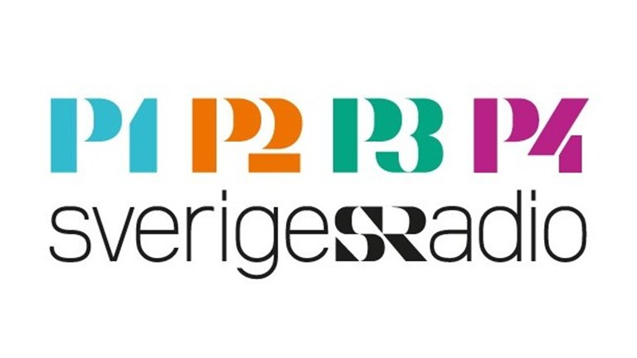
MARKETING SERVICES
Get valuable digital exposure to our network though a featured article in our monthly newsletter, eCurrents, distributed through our mailing list with 8,000 subscribers, published on our website and across all our social media channels
We feature our members across all social media channels – Facebook, LinkedIn, Instagram, Twitter, and YouTube – where we have a uniquely influential following, and a total of over 6,300 followers
We collaborate with several Swedish and American media outlets where we set up interviews for radio, web-TV, and newspapers, whether it is during an event or through other requests we can help you tailor it to your specific communication goals
Notes:
Our print and digital channels have a unique reach to an influential and active audience. Share the story of your brand in our channels which can be tailored to your specific communications goals.
Get valuable digital exposure to our network though a featured article in our monthly newsletter, eCurrents, distributed through our mailing list with 8,000 subscribers, published on our website and across all our social media channels with a total of 6,300 unique followers
We feature our members across all our social media channels – Facebook, LinkedIn, Instagram, Twitter, and YouTube – where we have a uniquely influential following, and a total of 6,300 followers
We work with a number of Swedish and American media outlets
Sveriges radio
Financial Times,

Slide 12
WHAT WE OFFER – MARKETING SERVICES
Get valuable digital exposure to our network though a featured article in our monthly newsletter, eCurrents, distributed through our mailing list with 8,000 subscribers, published on our website and across all our social media channels
We feature our members across all social media channels – Facebook, LinkedIn, Instagram, Twitter, and YouTube – where we have a uniquely influential following, and a total of 6,300 followers
We collaborate with several Swedish and American media outlets where we set up interviews for radio, web-TV, and newspapers, whether it is during an event or through other requests we can help you tailor it to your specific communication goals
Notes:
Our print and digital channels have a unique reach to an influential and active audience. Share the story of your brand in our channels which can be tailored to your specific communications goals.
Get valuable digital exposure to our network though a featured article in our monthly newsletter, eCurrents, distributed through our mailing list with 8,000 subscribers, published on our website and across all our social media channels with a total of 6,300 unique followers
We feature our members across all our social media channels – Facebook, LinkedIn, Instagram, Twitter, and YouTube – where we have a uniquely influential following, and a total of 6,300 followers
We work with a number of Swedish and American media outlets
Sveriges radio
Financial Times, Fox News

